Slide 1
TALLADEGA
COUNTY
ALUMNAE
CHAPTER (TCAC)
DELTA SIGMA THETA SORORITY, INC.
PRESENTS

Slide 3
OUR MEMBERS INVITE YOU TO JOIN US IN BRINGING AWARENESS TO HEALTHY HEART INITIATIVES

Slide 4
IN 2004, THE AMERICAN HEART ASSOCIATION (AHA) STEPPED FORWARD TO BRING AWARENESS TO HEART DISEASE AND STROKE AS THE NUMBER ONE KILLER OF WOMEN. AHA CREATED:
FOR WOMEN
THE RED DRESS IS THE NATIONAL SYMBOL FOR WOMEN AND HEART DISEASE AWARENESS
TO ADDRESS THIS PROBLEM

Slide 5
OUR MEMBERS WEAR THEIR RED DRESSES

Slide 6
Soror Juliette Smith, Go Red Coordinator
Soror Angela McKenzie, PP&D Chair
URGE YOU TO JOIN US ON
FEBRUARY 5, 2021
FOR
GO RED AND WEAR RED DAY!
Note: In 2005, DST, Inc. became the first sorority to form a national partnership with the American Heart Association for the
“GO RED FOR WOMEN”
campaign and launched
“ GO RED AND WEAR RED“
in February 2013.

Slide 7
THE WOMAN WHO GOES RED WILL HAPPILY OBSERVE:

Slide 8
HERE ARE SOME HELPFUL TIPS TO KEEP YOUR HEART HEALTHY
EAT A HEALTHY DIET
TALK WITH FRIENDS
EXCERCISE
SEE YOUR DOCTOR

Slide 9
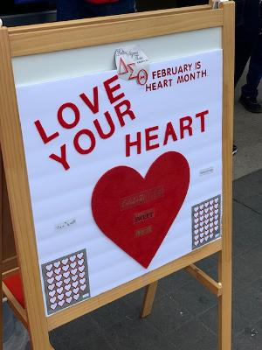
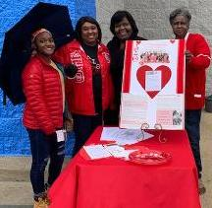
DON’T FORGET FEBRUARY 5, 2021!
LOVE YOUR HEART
AND ENCOURAGE OTHERS.
SUPPORT THE AMERICAN HEART ASSOCIATION!

